Slide 1

Computer Network and IoT
Introduction to Terminologies of Computer Network Part - 02
By: Pankaj Mishra
Assistant Professor
Dept. of CSE/IT
JIIT, Noida

Slide 2
Content
Type of Connection
Physical Topology
Categories of Networks
THE INTERNET
Protocols

Slide 3
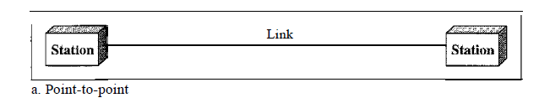
Type of Connection
Point-to-Point - A point-to-point connection provides a dedicated link between two devices. The entire capacity of the link is reserved for transmission between those two devices. Most point-to-point connections use an actual length of wire or cable to connect the two ends, but other options, such as microwave or satellite links, are also possible. When you change television channels by infrared remote control, you are establishing a point-to-point connection between the remote control and the elevision's control system.

Slide 4
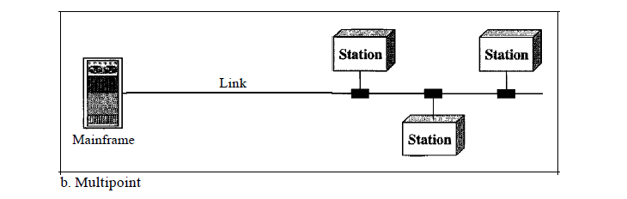
Multipoint - A multipoint (also called multidrop) connection is one in which more than two specific devices share a single link. In a multipoint environment, the capacity of the channel is shared, either spatially or temporally. If several devices can use the link simultaneously, it is a spatially shared connection. If users must take turns, it is a timeshared connection.

Slide 5
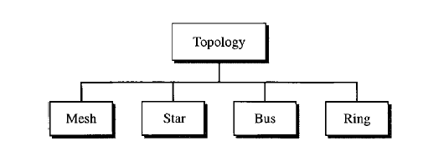
Physical Topology
The term physical topology refers to the way in which a network is laid out physically. Two or more devices connect to a link; two or more links form a topology.
The Topology of a network is the geometric representation of the relationship of all the links and linking devices (usually called nodes) to one another.

Slide 6
Mesh-
In a mesh topology, every device has a dedicated point-to-point link to every other device.
The term dedicated means that the link carries traffic only between the two devices it connects.
To find the number of physical links in a fully connected mesh network with n nodes, we first consider that each node must be connected to every other node. Node 1 must be connected to n - I nodes, node 2 must be connected to n - 1 nodes, and finally node n must be connected to n - 1 nodes. We need n(n - 1) physical links.
However, if each physical link allows communication in both directions (duplex mode), we can divide the number of links by 2. In other words, we can say that in a mesh topology, we need
n(n -1) /2

Slide 7
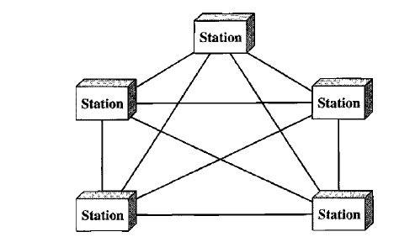

Slide 8
Advantages
First, the use of dedicated links guarantees that each connection can carry its own data load, thus eliminating the traffic problems that can occur when links must be shared by multiple devices.
Second, a mesh topology is robust. If one link becomes unusable, it does not incapacitate the entire system.
Third, there is the advantage of privacy or security. When every message travels along a dedicated line, only the intended recipient sees it
Fault identification and fault isolation easy.
Disadvantages
First, because every device must be connected to every other device, installation and reconnection are difficult.
It’s costly.

Slide 9
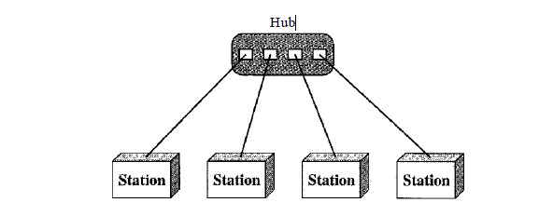
Star-
In a star topology, each device has a dedicated point-to-point link only to a central controller, usually called a hub.
The controller acts as an exchange: If one device wants to send data to another, it sends the data to the controller, which then relays the data to the other connected device.

Slide 10
Advantages
A star topology is less expensive than a mesh topology.
it is easy to install and reconfigure.
It is robustness, If one link fails, only that link is affected. All other links remain active.
Fault identification and fault isolation is easy.
Disadvantage
One big disadvantage of a star topology is the dependency of the whole topology on one single point, the hub. If the hub goes down, the whole system is dead.
Although a star requires far less cable than a mesh, each node must be linked to a central hub. For this reason, often more cabling is required in a star than in some other topologies (such as ring or bus).

Slide 11
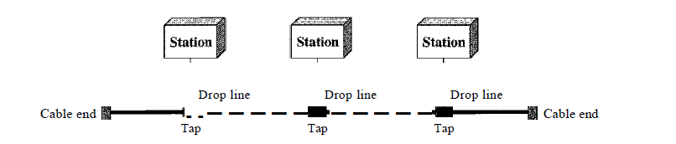
Bus Topology-
A bus topology is multipoint. One long cable acts as a backbone to link all the devices in a network
Nodes are connected to the bus cable by drop lines and taps.
As a signal travels along the backbone, some of its energy is transformed into heat. Therefore, it becomes weaker and weaker as it travels farther and farther. For this reason there is a limit on the number of taps a bus can support.

Slide 12
Advantage
Advantages of a bus topology include ease of installation.
Less cost from mesh and star topology.
Disadvantage
Difficult reconnection and fault isolation.
Signal reflection at the taps can cause degradation in quality. This degradation can be controlled by limiting the number and spacing of devices connected to a given length of cable.
A fault or break in the bus cable stops all transmission.

Slide 13
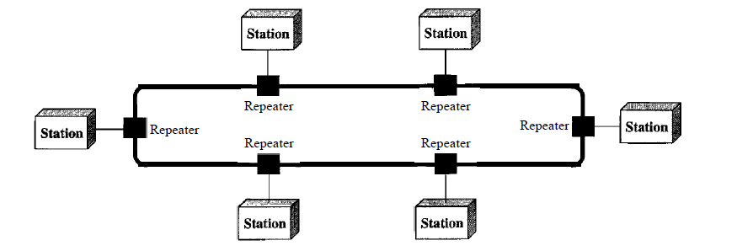
Ring Topology-
In a ring topology, each device has a dedicated point-to-point connection with only the two devices on either side of it.
A signal is passed along the ring in one direction, from device to device, until it reaches its destination. Each device in the ring incorporates a repeater.
When a device receives a signal intended for another device, its repeater regenerates the bits and passes them along.

Slide 14
Advantage
A ring is relatively easy to install and reconfigure. Each device is linked to only its immediate neighbors (either physically or logically). To add or delete a device requires changing only two connections.
Fault isolation is simplified. Generally in a ring, a signal is circulating at all times. If one device does not receive a signal within a specified period, it can issue an alarm. The alarm alerts the network operator to the problem and its location.
Disadvantage
Unidirectional traffic can be a disadvantage.
In a simple ring, a break in the ring (such as a disabled station) can disable the entire network.

Slide 15
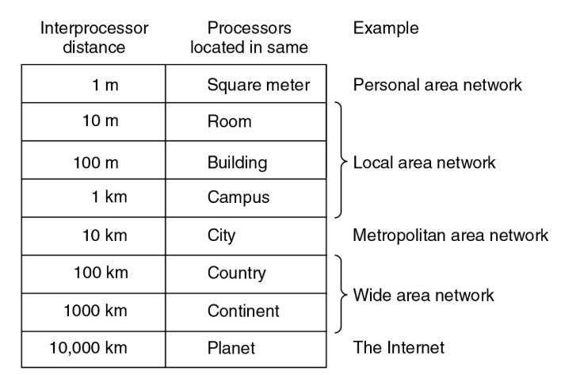
Categories of Networks

Slide 16
The Internet
The Internet has revolutionized many aspects of our daily lives. It has affected the way we do business as well as the way we spend our leisure time. Count the ways you've used the Internet recently. Perhaps you've sent electronic mail (e-mail) to a business associate, paid a utility bill, read a newspaper from a distant city, or looked up a local movie schedule-all by using the Internet. Or maybe you researched a medical topic, booked a hotel reservation, chatted with a fellow Trekkie, or comparison-shopped for a car. The Internet is a communication system that has brought a wealth of information to our fingertips and organized it for our use.
In the mid-1960s, mainframe computers in research organizations were standalone devices. Computers from different manufacturers were unable to communicate with one another. The Advanced Research Projects Agency (ARPA) in the Department of Defense (DoD) was interested in finding a way to connect computers so that the researchers they funded could share their findings, thereby reducing costs and eliminating duplication of effort.

Slide 17
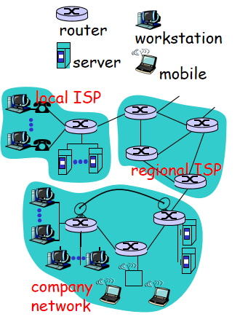
By 1969, ARPANET was a reality. Four nodes, at the University of California at Los Angeles (UCLA), the University of California at Santa Barbara (UCSB), Stanford Research Institute (SRI), and the University of Utah, were connected via the IMPs to form a network. Software called the Network Control Protocol (NCP) provided communication between the hosts.

Slide 18
millions of connected computing devices: hosts = end systems
running network apps
communication links
fiber, copper, radio, satellite
transmission rate = bandwidth
routers: forward packets (chunks of data)
protocols control sending, receiving of msgs
e.g., TCP, IP, HTTP, FTP, PPP
Internet: “network of networks”
loosely hierarchical
public Internet versus private intranet
Internet standards
RFC: Request for comments
IETF: Internet Engineering Task Force

Slide 19
Protocols
A protocol is a set of rules that govern data communications.
The key elements of a protocol are syntax, semantics, and timing.
Syntax- The term syntax refers to the structure or format of the data, meaning the
order in which they are presented. For example, a simple protocol might expect the
first 8 bits of data to be the address of the sender, the second 8 bits to be the address
of the receiver, and the rest of the stream to be the message itself.
Semantics.- The word semantics refers to the meaning of each section of bits.
How is a particular pattern to be interpreted, and what action is to be taken based
on that interpretation? For example, does an address identify the route to be taken
or the final destination of the message?

Slide 20
Timing- The term timing refers to two characteristics: when data should be sent
and how fast they can be sent. For example, if a sender produces data at 100 Mbps
but the receiver can process data at only 1 Mbps, the transmission will overload the
receiver and some data will be lost.

Slide 21
Thank You

